Slide 1
Video Conferencing Systems
RoadMap H1’ 2023

Slide 2

VCS RoadMap, H1’2023
Q1
Q2
Q3
Q4
PVCCF2M202
PSVCCU8M201
PVCCU13M201
PVCCU12M201
PVCCU8N002
PSVCCF2N001

Slide 3


VCS RoadMap, H1’2023
Q1
Q2
Q3
Q4
PVCCU12M601
PVCCU8M601
PVCSN0M601
PVCSN0M602
PVCSN0M401
PSVCMN0M701

Slide 4
VCS LineUp, H1’2023
PVCCF2M202 (Windows Hello Camera)
FHD / 2MP / Windows Hello 4.x / 2 mic / 1m (Range) / Connection via USB 3.0
PSVCCU8M201 (8MP UHD Camera) (*Coming soon)
4K UHD / SONY Sensor / 8MP / e-PTZ / AI intelligent tracking / 2 mic / 5m (Range) / Connection via USB 2.0 Type-C
PVCCU13M201 (13MP UHD Camera)
4K UHD / SONY Sensor / 13MP / 2 mic / 4m (Range) / Connection via USB 3.0 Type-C
PVCCU12M201 (Panoramic VC Camera)
4K UHD / OmniVision Sensor / 12MP / Audio tracking / 2 mic / 4m (Range) / Connection via USB Type-C
PVCCU8N002 (4K PTZ Camera Alpha)
4K UHD / SONY Sensor / 8.4MP / PTZ / NDI / AI intelligent tracking / No mic / PoE / Connection via HDMI 2.0, USB 3.0, RJ45 or 3G-SDI
PSVCCF2N001 (Wireless PTZ Camera Gamma)
FHD / PANASONIC Sensor / 2MP / PTZ / Wireless / No mic / PoC / Connection via HDMI 1.3, Wi-Fi (5G), RJ45 or 3G-SDI

Slide 5
VCS LineUp, H1’2023
PVCCU12M601 (Collaboration Bar Alpha)
4K UHD / SONY Sensor / 12MP / e-PTZ / AI intelligent tracking / 6 mic / 8m (Range) / 8W / Connection via USB 3.0 Type-C or AUX
PVCCU8M601 (Collaboration Bar Gamma)
4K UHD / SONY Sensor / 8MP / e-PTZ / AI intelligent tracking / 6 mic / 6m (Range) / Connection via USB 3.0 Type-B or AUX
PVCSN0M601 (Speakerphone Alpha)
5W / 6 mic / 5m (Radius) / Wireless charging / Connection via USB 3.0 Type-C, AUX or BT4.2+EDR
PVCSN0M602 (Speakerphone Gamma)
3W / 6 mic / 5m (Radius) / Connection via USB Type-C or BT5.0
PVCSN0M401 (Speakerphone Delta)
5W / 4 mic / 6m (Radius) / Connection via USB Type-C or BT5.0
PSVCMN0M701 (Digital Array Microphone Alpha)
7 mic / 8m (Radius) / Connection via USB 2.0 or AUX

Slide 6
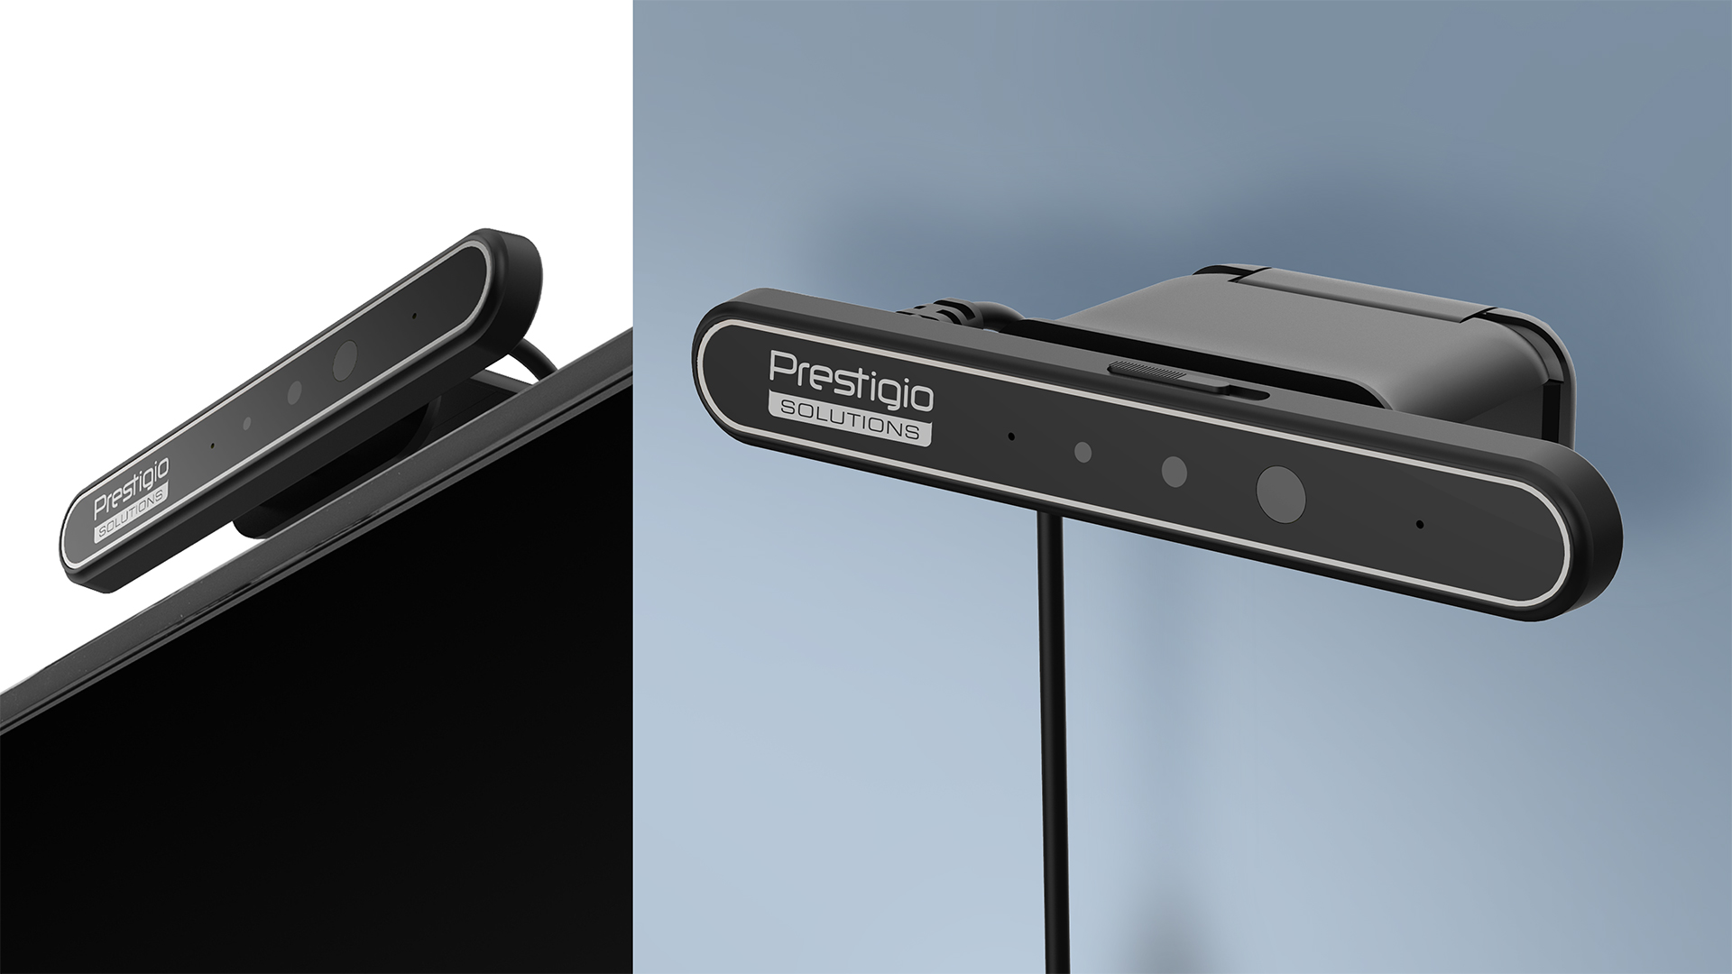

WINDOWS HELLO CAMERA
BIOMETRIC AUTHENTICATION
via Windows Hello function (face recognition) & built-in physical privacy switch for MAX security
FHD RESOLUTION
For smooth video collaboration
PLUG&PLAY
Compatible with Windows 10 / 11
ADVANCED SOUND
2 built-in microphones for comfortable audio collaboration

Slide 7


WINDOWS HELLO CAMERA
(PVCCF2M202)
Web camera with Windows Hello feature to provide MAX security and comfort of use.
Recommended OS: Windows 10.
Biometric workplace protection: IR-camera and built-in physical privacy switch for MAX security
Plug&Play function. Can be connected via USB cable.
Smooth and minimal design, balanced pricing
Perfect to use for personal working place, at small meeting rooms or home offices.

Slide 8

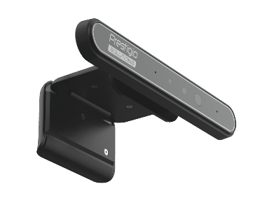
WINDOWS HELLO CAMERA
(PVCCF2M202)
RGB CAMERA RESOLUTION | FHD 1920 x 1080 (30fps)
PIXEL | 2.1M
OUTPUT FORMAT | MJPG/YUY2
FIELD OF VIEW | DFOV: 79.4⁰ / HFOV: 72.8⁰ / VFOV: 44.2⁰
IR CAMERA RESOLUTION | 640 x 480 (100fps)
IR LED | Centroid wavelength 850 nm
MIC ELEMENTS | 2
AUDIO SUPPORT SENSOR | USB 2.0 audio codec for digital microphone recorder
VOICE PICKUP RANGE | 0~1m
PHYSICAL PRIVACY SWITCH | Support
INTERFACES | USB 3.0 x 1 (USB 2.0 for data, USB 3.0 for power)
WINDOWS HELLO | Windows Hello 4.x
PLATFORM SUPPORT | Windows 10/11 (without driver) to support Windows Hello, Windows 7/8/8.1 (32/64 bit OS) Web Cam support only
DIMENSIONS (LxWxH), MM | 115 x 22 x 7.35
WEIGHT (NET/GROSS), G | 110 / 330
IN THE BOX | QSG, Warranty card
RDP / RRP | $67 / $80 w/o VAT
Production lead time | 2.5 months
Plus delivery | air – 2 weeks, train – 3 weeks
One model MOQ | 2000 pcs from all subs
Orders based on commitment from all subs

Slide 9
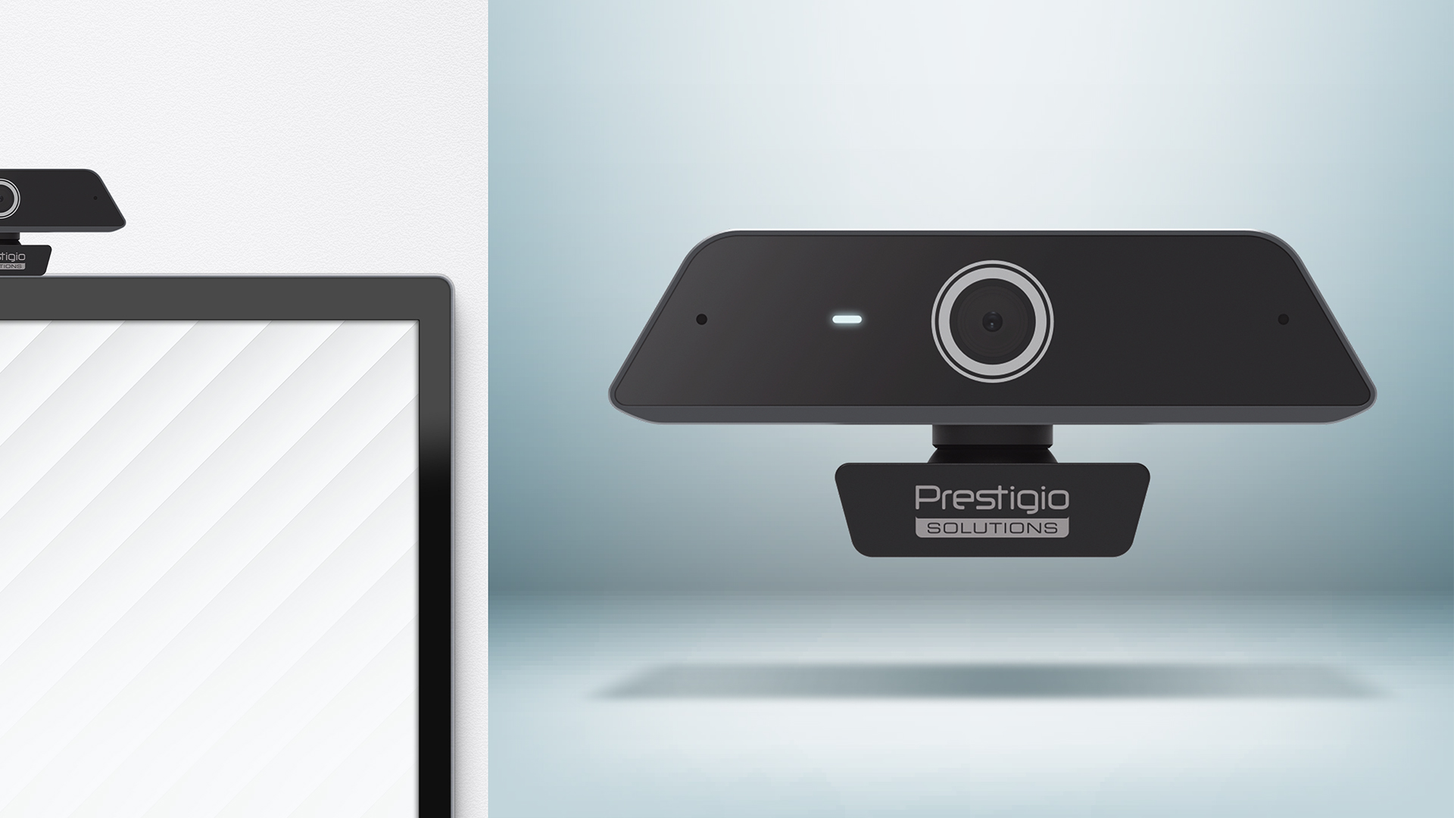

13MP UHD
CAMERA
4K
Resolution and 30fps for clear image and max realism
$${80}^{°}$$
Field of view
AUTOFOCUS
For smooth video collaboration
METAL CASE
For maximum durability
ADVANCED SOUND
2 built-in microphones with 4m voice pickup range for comfortable audio collaboration

Slide 10

13MP UHD
CAMERA
(PVCCU13M201)
Small & functional video conferencing solution for smooth and clear collaboration.
Compatible with most OS and devices: Multiboards, laptops, PCs, smartphones, etc.
Unrivaled picture quality with 13MP camera and 4K resolution
Plug&Play function. USB Type-C connection. Can be installed on screen, wall or on a tripod
Smooth and minimal design, balanced pricing
Perfect to use at open office spaces, small meeting rooms, executive office, etc.

Slide 11
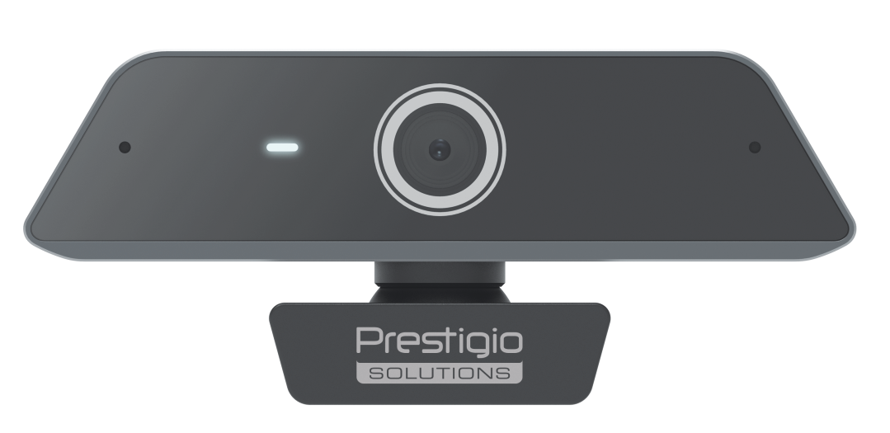
13MP UHD CAMERA
(PVCCU13M201)
RESOLUTION | 4K (30fps)
PIXEL | 13M
IMAGE SENSOR | 1/3.06” SONY sensor
OUTPUT FORMAT | MJPG/YUY2/H.264
FIELD OF VIEW | DFOV: 79.8⁰ / HFOV: 67.8⁰ / VFOV: 53.1⁰
DIGITAL NOISE REDUCTION | 2D & 3D digital noise reduction
WHITE BALANCE/ EXPOSURE | Auto/Auto
BACKLIGHT COMPENSATION | Support
MICROPHONE QUANTITY | 2
VOICE PICUP RANGE | 0~4m
INTERFACES | USB Type-C (Device) x 1
DIMENSIONS (LxHxD), MM | 116 x 54.3 x 48
WEIGHT (NET/GROSS), G | 151 / 376
IN THE BOX | QSG, Warranty card, USB Cable x 1
RDP / RRP | $97 / $119 w/o VAT
Production lead time | 2.5 months
Plus delivery | air – 2 weeks, train – 3 weeks
One model MOQ | 500 pcs from all subs
Orders based on commitment from all subs

Slide 12
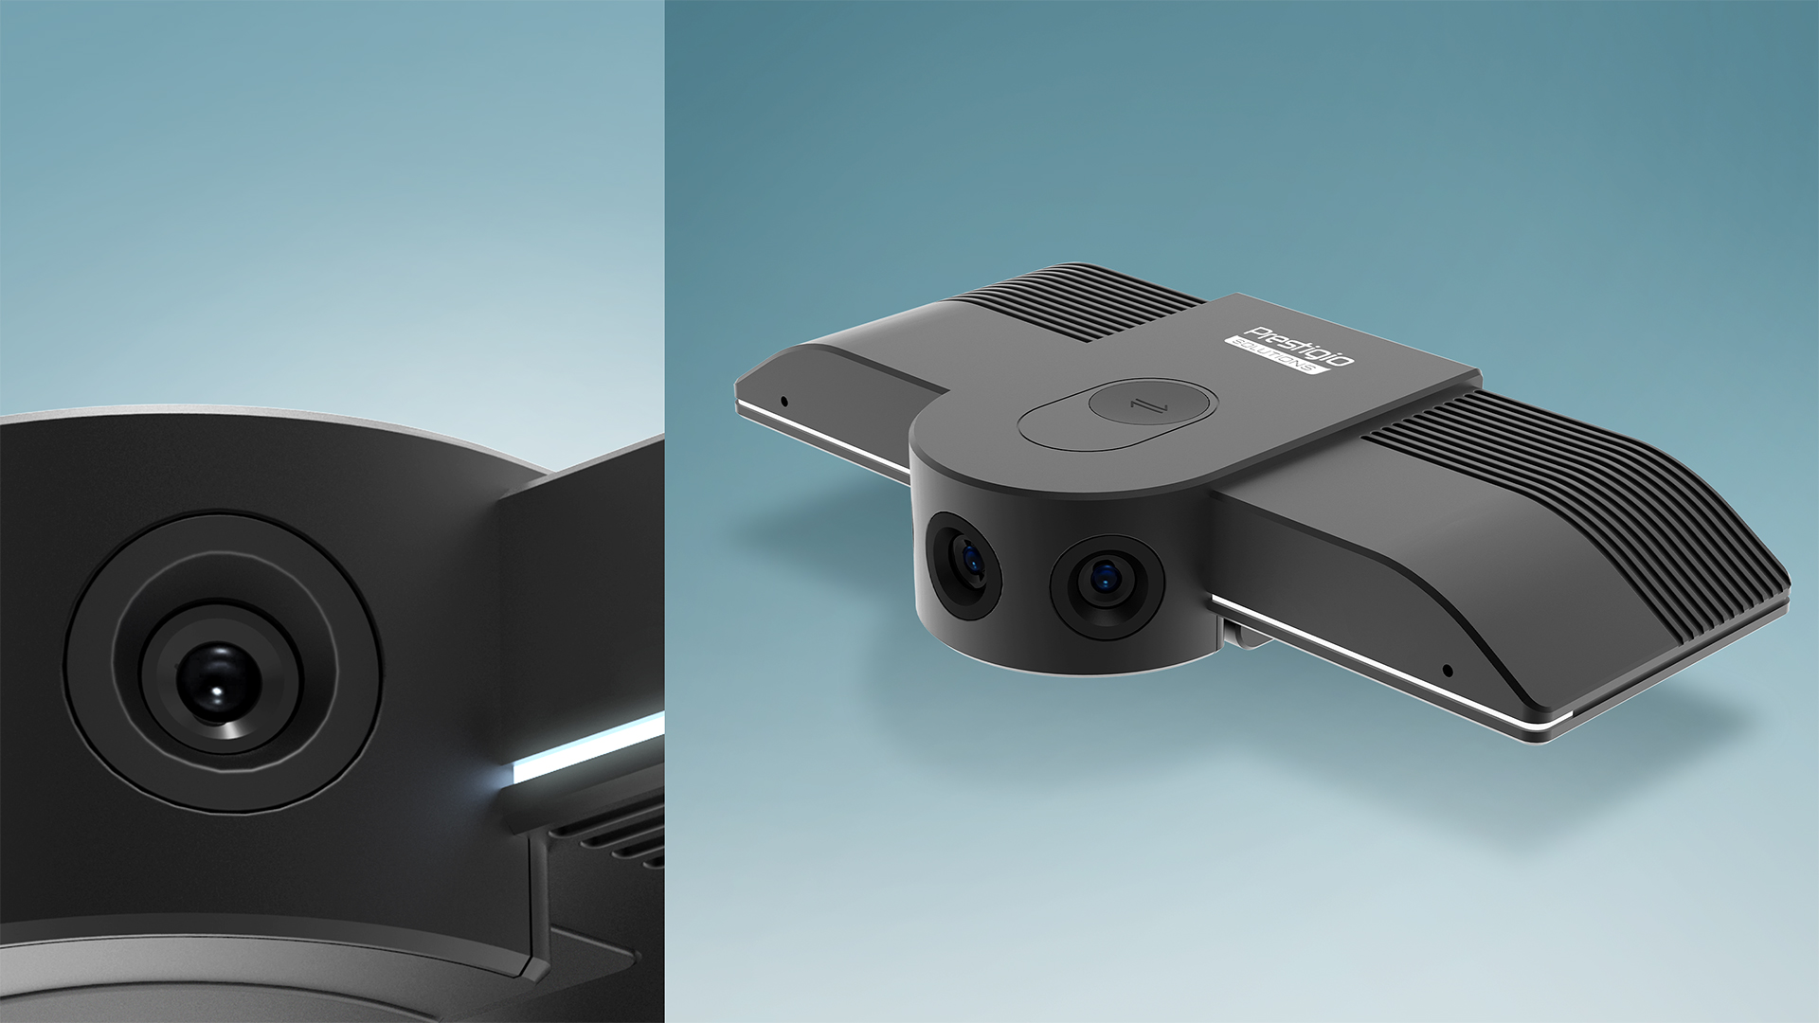

PANORAMIC
VC CAMERA
ADVANCED SOUND
2 built-in microphones with audio tracking
$${180}^{°}$$
Viewing Angle
4K
Camera with people recognition
USB HOST PORT
Any speakerphone direct connection to the camera

Slide 13
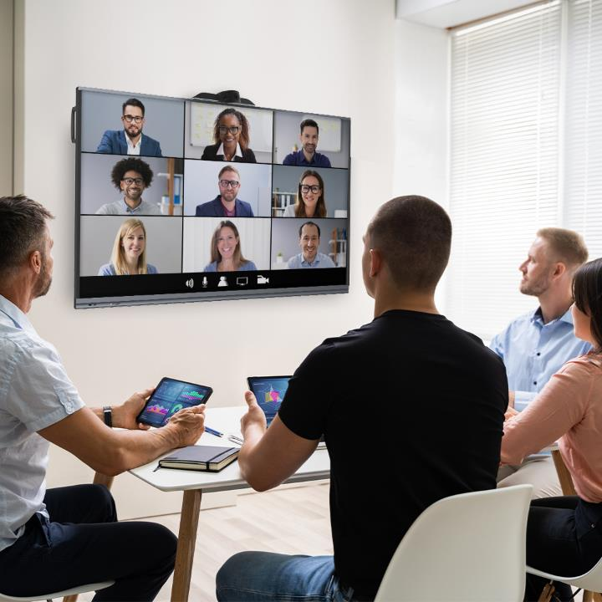

PANORAMIC
VC CAMERA
(PVCCU12M201)
Full 180 Degree Coverage VC solution. Perfect for small meeting rooms.
Widest viewing angle of ${\text{180}}^{o}$
Modern and minimal design, balanced pricing
Plug&Play function.
Perfect to use at meeting rooms, executive office, etc.

Slide 14
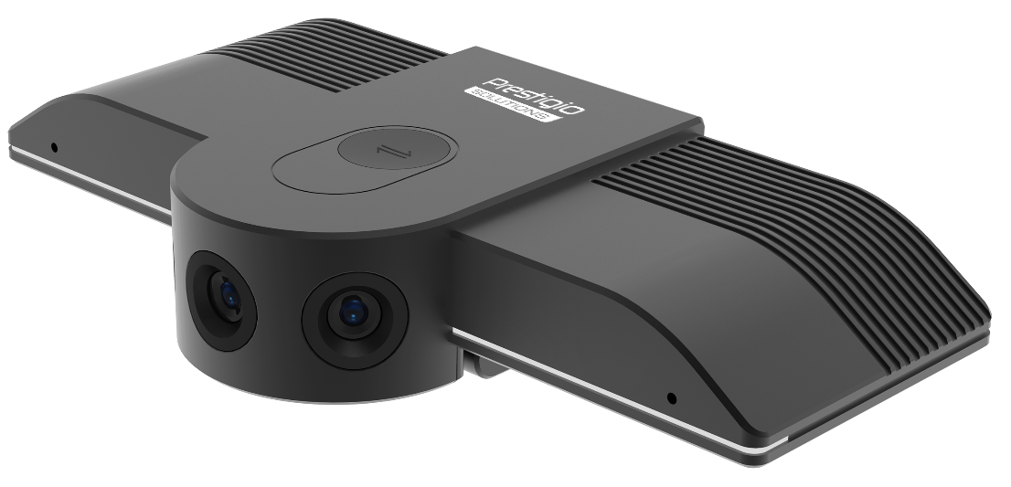
PANORAMIC VC CAMERA
(PVCCU12M201)
RESOLUTION | 4K (30fps)
PIXEL | 12M
OUTPUT FORMAT | MJPG/YUY2/H.264
FIELD OF VIEW | 180⁰
FOCUS MODE / DISTANCE | Fixed Focus/ 1.5m
DIGITAL NOISE REDUCTION | 2D & 3D digital noise reduction
MIC ELEMENTS | 2
VOICE PICUP RANGE | 0~4m
INTERFACES | USB Type-C (Device) x 1, USB Type-A (Host) x 1
DIMENSIONS (LxHxD), MM | 144 x 26 x 43
WEIGHT (NET/GROSS), G | 209 / 502
IN THE BOX | QSG, Warranty card, USB Cable x 1, Wall Mount x 1
RDP / RRP | $365 / $449 w/o VAT
Production lead time | 2.5 months
Plus delivery | air – 2 weeks, train – 3 weeks
One model MOQ | 500 pcs from all subs
Orders based on commitment from all subs

Slide 15
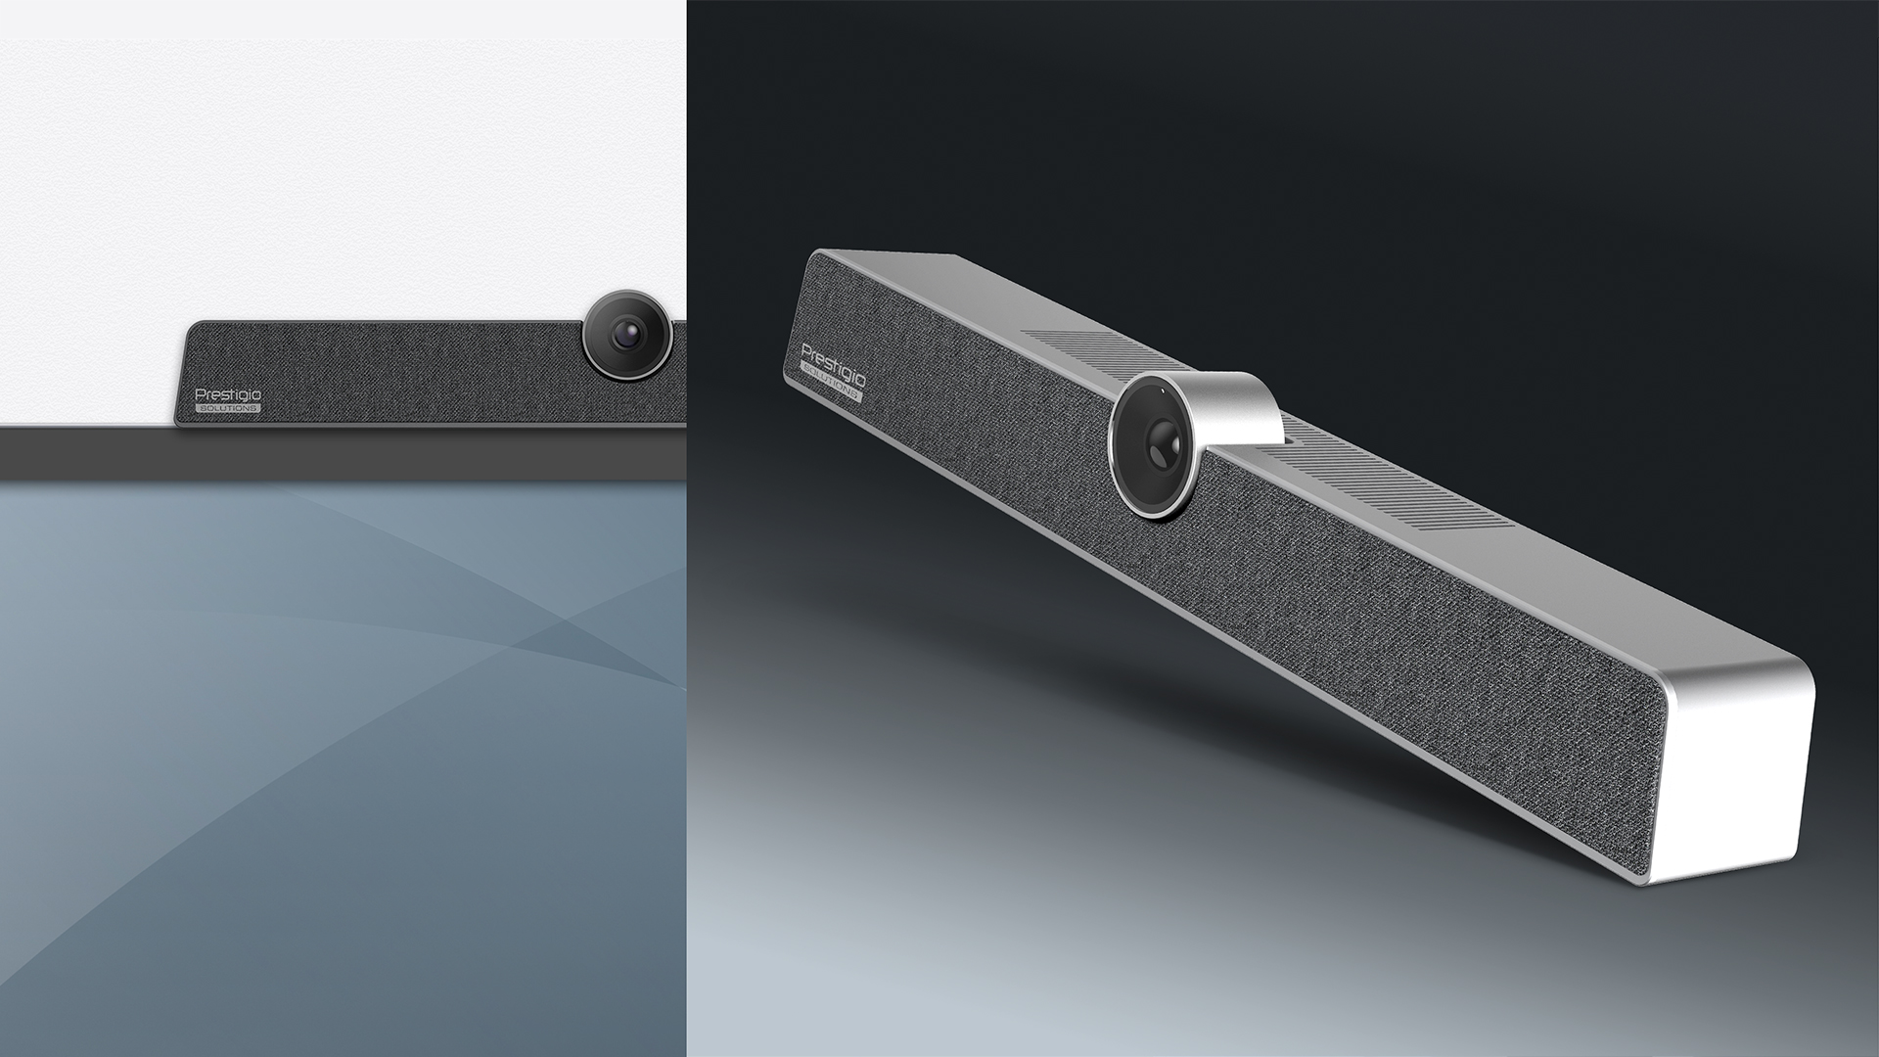
COLLABORATION BAR ALPHA
ALL-IN-ONE
Camera, speaker and microphone
6-ELEMENT
Mic array and 8m voice pickup range
120⁰
Viewing Angle
4K
Camera with 5X digital zoom
AI INTELLIGENT TRACKING
Presenter smooth automatic tracking

Slide 16

COLLABORATION BAR ALPHA (PVCCU12M601)
Integrated with both UHD camera and Hi-Fi speakerphone. It's a grab-n-go product for online meetings.
Compatible with most OS and devices: Multiboards, laptops, PCs, etc.
Easy & flexible installation: mount on the wall or put it on a desk
Smooth and minimal design, balanced pricing
Perfect to use at open office spaces, small and medium meeting rooms, executive office, etc.

Slide 17
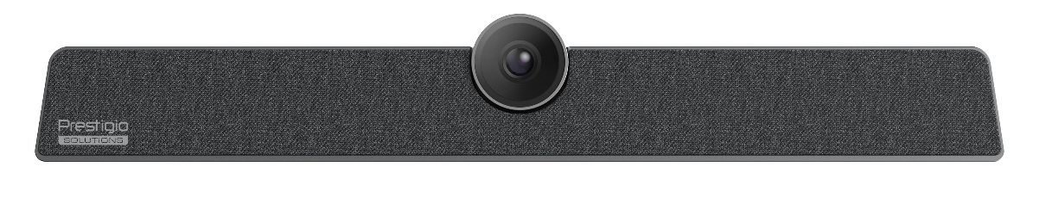
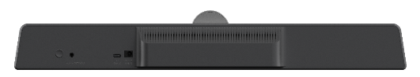
COLLABORATION BAR ALPHA (PVCCU12M601)
RESOLUTION | UHD (3840 x 2160)
PIXEL | 12M
IMAGE SENSOR | 1/2.3” SONY sensor
OUTPUT FORMAT | MJPG/YUY2/H.264
FIELD OF VIEW | DFOV: 120⁰
FOCUS MODE / DISTANCE | Fixed Focus / 2m
DIGITAL ZOOM | 5X
SOUND CHANNEL | 1.0
OUTPUT POWER | 1 x 8W
DIGITAL NOISE REDUCTION | 2D & 3D digital noise reduction
MIC ELEMENTS | 6
VOICE PICUP RANGE | 0~8m
AI INTELLIGENT TRACKING | Supported
INTERFACES | USB Type-C x 1, AUX IN/OUT x 1, DC 2.0 x 1
DIMENSIONS (LxHxD), mm | 462 x 76 x 93
WEIGHT (NET/GROSS), kg | 0.945 / 2.239
IN THE BOX | QSG, Warranty card, USB Cable x 1, Remote Control x 1, Power Adapter x 1, Wall-mounted Components x 1, Peeping cover x 1
RDP / RRP | $344 / $424 w/o VAT
Production lead time | 2.5 months
Plus delivery | air – 2 weeks, train – 3 weeks
One model MOQ | 500 pcs from all subs
Orders based on commitment from all subs

Slide 18
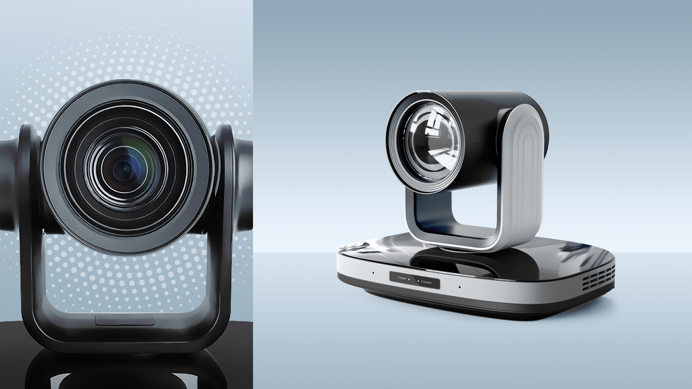

4K PTZ CAMERA
ALPHA
192 TIMES ZOOM RATIO
12x Optical and 16x digital zoom
4K
UHD camera with 60 frames per second
POE SUPPORT
Power over Ethernet
AI INTELLIGENT TRACKING
Smooth automatic tracking
of human shape
PTZ FUNCTION
Horizontal rotation angle ±170⁰, Vertical rotation angle -30° ~ +90°

Slide 19


4K PTZ CAMERA
ALPHA (PSVCCU8N002)
4K UHD camera with smooth pan-tilt-zoom operation to set new standards for mid-to-large meeting rooms.
4K 60fps imaging system with 12x optical and 16x digital zoom to ensure unsurpassed video quality
Smooth pan-tilt-zoom operation for the most comfortable work
Multiple outputs for easy plug&play,
PoE function support
Smooth and minimal design, balanced pricing
Perfect to use for medium and large meeting rooms and conference halls.

Slide 20
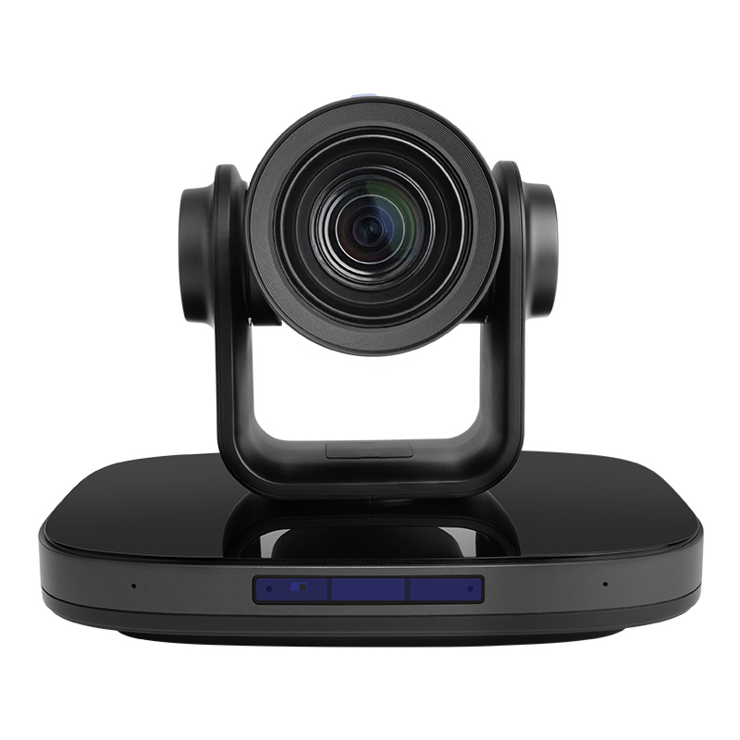
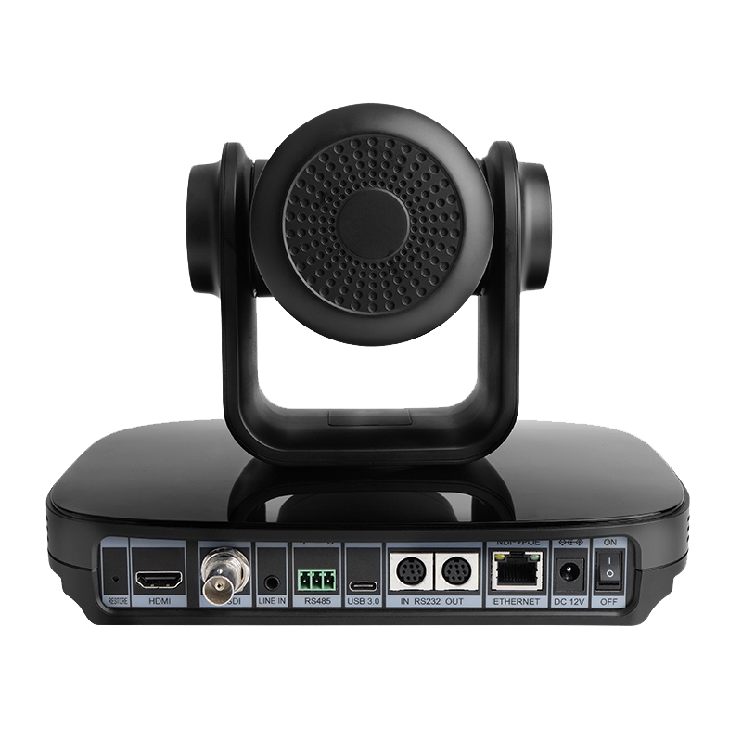
4K PTZ CAMERA ALPHA (PSVCCU8N002)
RESOLUTION | 4K (60fps)
PIXEL | 8.4M
SENSOR | 1/2.8” SONY high quality UHD CMOS sensor
OUTPUT FORMAT | MJPG/YUY2/H.264
FIELD OF VIEW (HORIZONTAL/VERTICAL) | 80.8° ~ 7.5° / 49.9° ~ 4.3°
ROTATION RANGE (HORIZONTAL/VERTICAL) | ±170⁰ / -30° ~ +90°
LENS | 12x, f = 3.47mm ~41.65mm, F 1.84 ~ F 3.72
DIGITAL ZOOM | 16x
DIGITAL NOISE REDUCTION | 2D & 3D digital noise reduction
IMAGE FREEZE | Supported
USB AUDIO | Supported
HORIZONTAL & VERTICAL FLIP | Supported (built-in gravity sensor)
AI INTELLIGENT TRACKING | Supported
OPERATING SYSTEM | Windows 7, Windows 8, Windows 10, Windows 11, Mac OS X, Linux, Android
INTERFACES | RJ45 (POE) x 1, RS232 IN x1, RS232 OUT x1, RS485 x 1, HDMI 2.0 x 1, LINE IN 3.5mm Audio Interface x 1, 3G-SDI x 1, USB 3.0 Type-C x 1, JEITA type (DC IN 12V)
IN THE BOX | QSG, Warranty card, USB Cable, Power Supply, Remote control
RDP / RRP | $952 / $1172 w/o VAT
Production lead time | 2.5 months
Plus delivery | air – 2 weeks, train – 3 weeks
One model MOQ | 100 pcs from all subs
Orders based on commitment from all subs

Slide 21
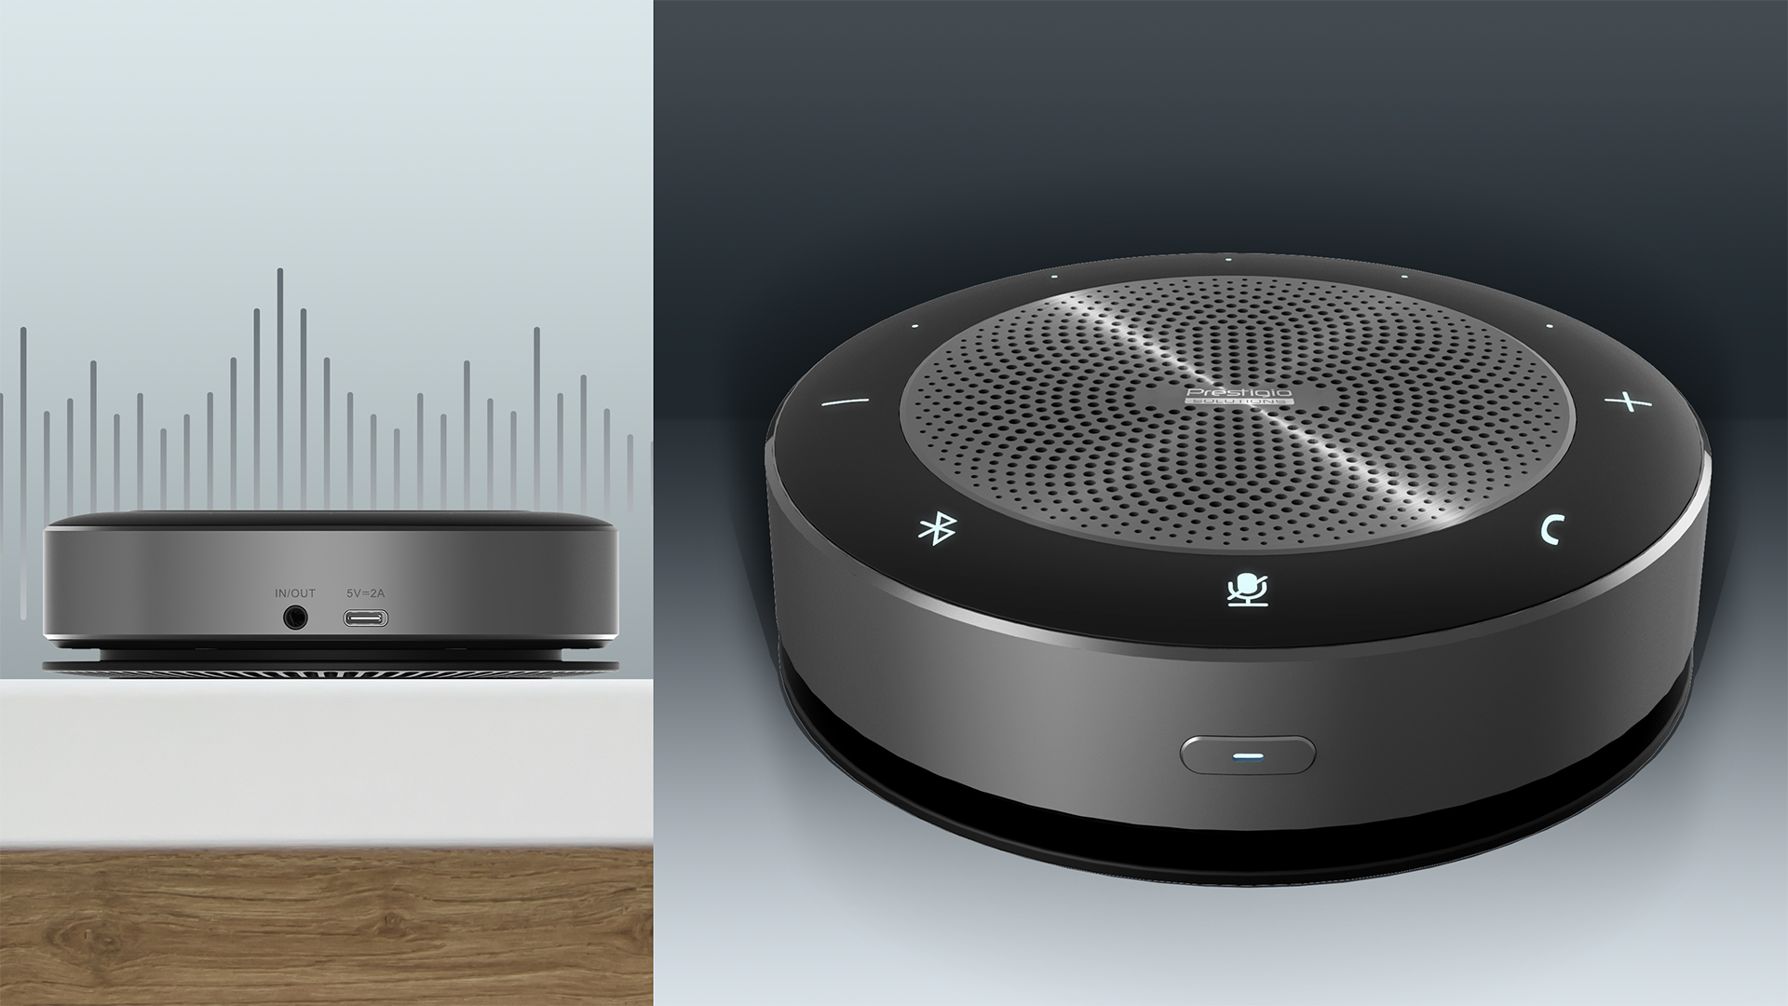
SPEAKERPHONE
ALPHA
METAL CASE
For maximum durability
WIRELESS& PORTABLE
Up to 8 hours of battery life, wireless charging function
6-ELEMENT
Mic array and 5m voice pickup omnidirectionally
PLUG&PLAY
Bluetooth/USB/AUX connection

Slide 22
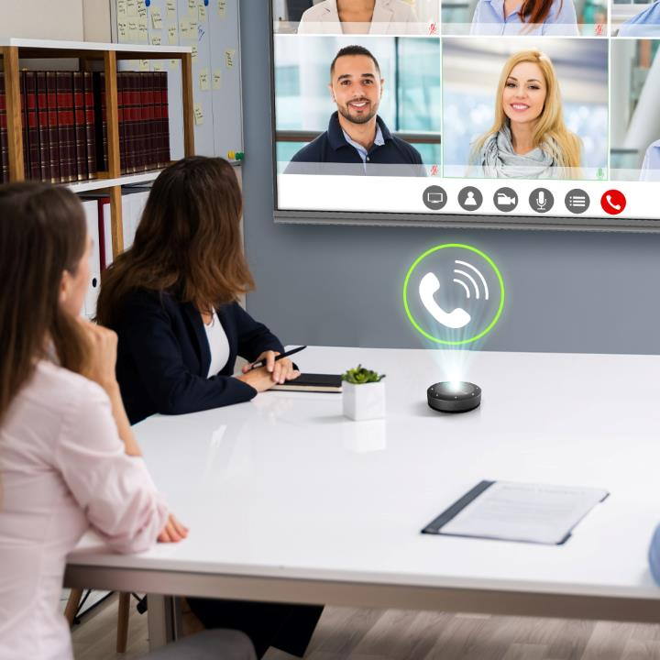
SPEAKERPHONE ALPHA (PVCSN0M601)
Wireless and portable. It's a grab-n-go solution for online communication.
Compatible with most OS and devices: Multiboards, laptops, PCs, smartphones, etc.
Plug&play function. Can be connected via Bluetooth, USB or AUX cables.
Smooth and minimal design, balanced pricing
Supports wireless charging, up to 8 hours of battery life
Perfect to use at open office spaces, meeting rooms of any size, executive office, etc.

Slide 23
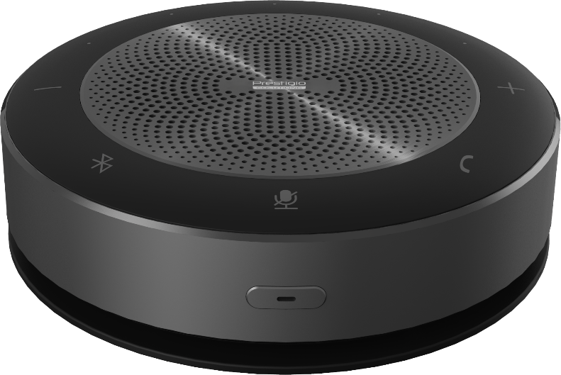
SPEAKERPHONE ALPHA (PVCSN0M601)
MICROPHONE | 6-Element Array, Omnidirectional
DIGITAL NOISE REDUCTION | 2D; 3D noise reduction
VOICE PICKUP RANGE | 5m (Radius)
SPEAKER SOUND CHANNEL | 1.0
OUTPUT POWER | 1 x 5W
INTERFACES | USB Type-C x 1 (Audio IN/OUT + Charge 5V/2A), AUX 3.5mm x 1 (Audio IN/OUT), BT4.2+EDR 2.4GHz
LED INDICATOR LIGHT | Power/Volume/Button/Battery charge
BATTERY CAPACITY | 7.4V/2200mAh
BATTERY CHARGING | Wired: 5V/2A, Wireless: 5W
CONTINUOUS WORKING TIME | 8h (Voice communication with the maximum volume)
DIMENSIONS (DIAMETER x HEIGHT), MM | 120 x 36.5
WEIGHT (NET/GROSS), g | 400 / 810
IN THE BOX | QSG, Warranty card, USB Type-C Cable x 1, Audio Cable 3.5mm x 1, USB Dongle(Bluetooth) x 1, Power adapter x 1
RDP / RRP | $127 / $156 w/o VAT
Production lead time | 2.5 months
Plus delivery | air – 2 weeks, train – 3 weeks
One model MOQ | 500 pcs from all subs
Orders based on commitment from all subs

Slide 24
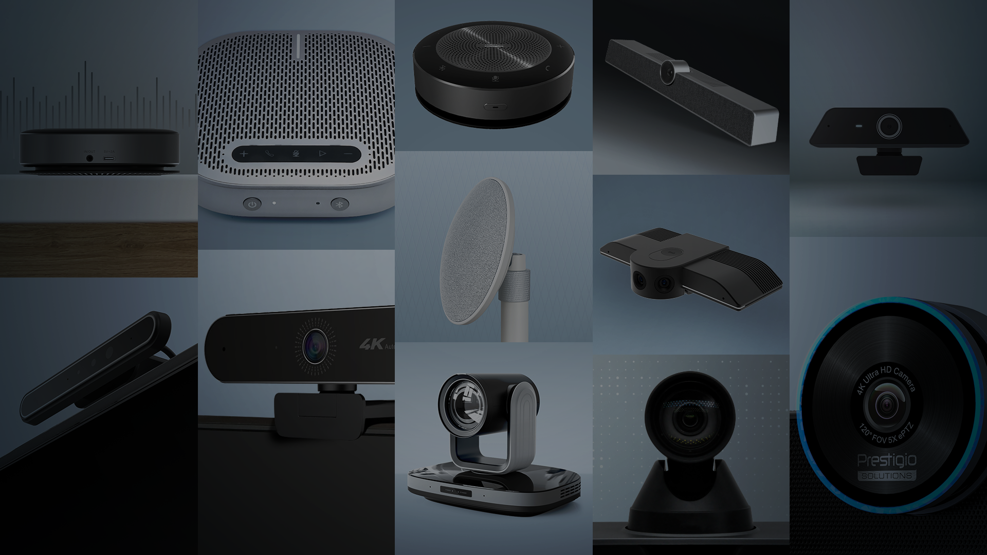
COMING SOON…

Slide 25
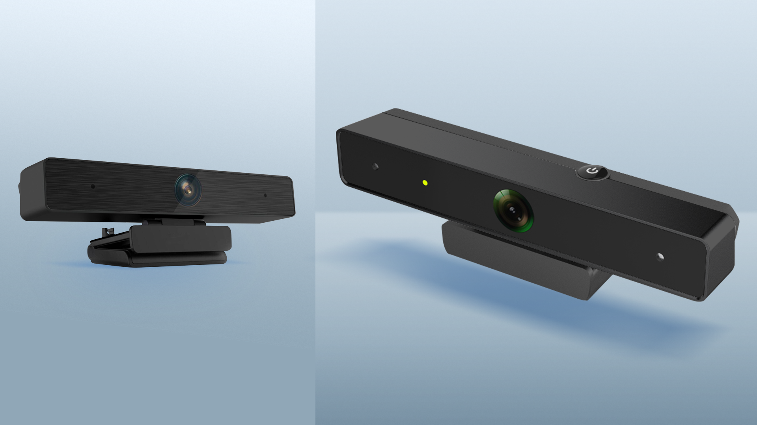


4K
Resolution and 30fps for clear image and max realism
8MP UHD CAMERA
AI INTELLIGENT TRACKING
Presenter smooth automatic tracking
$${98}^{°}$$
Field of view
e-PTZ
UVC / IR remote control
METAL CASE
For maximum durability
ADVANCED SOUND
2 built-in microphones with 5m voice pickup range for comfortable audio collaboration

Slide 26

8MP UHD CAMERA
(PSVCCU8M201)
Small & functional video conferencing solution for smooth and clear collaboration.
Compatible with most OS and devices: Multiboards, laptops, PCs, smartphones, etc.
Unrivaled picture quality with 8.5MP camera and 4K resolution
Plug&Play function. USB Type-C connection. Can be installed on screen, wall or on a tripod
Smooth and minimal design, balanced pricing
Perfect to use at open office spaces, small meeting rooms, executive office, etc.

Slide 27
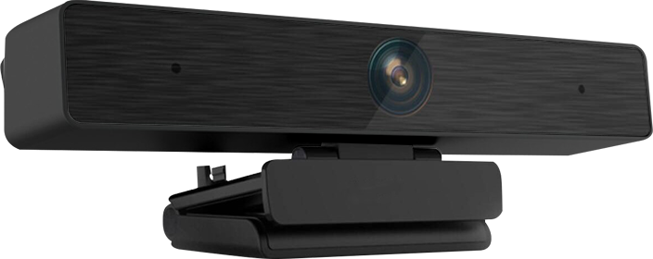
8MP UHD CAMERA
(PSVCCU8M201)
RESOLUTION | 4K (30fps)
PIXEL | 8.5M
IMAGE SENSOR | 1/2.5” SONY Low Illumination sensor
OUTPUT FORMAT | MJPG/YUY2
FIELD OF VIEW | DFOV: 98⁰ HFOV: 90⁰ VFOV: 60⁰
FOCUS TYPE | Fixed focal
DIGITAL ZOOM | 16x
EPTZ | Yes (UVC / IR remote control)
DIGITAL NOISE REDUCTION | 2D; 3D noise reduction
WHITE BALANCE/ EXPOSURE | Auto/Auto
MICROPHONE QUANTITY | 2
VOICE PICUP RANGE | 0.3~5m
AI INTELLIGENT TRACKING | Supported
INTERFACES | USB 2.0 Type-C x 1
ROTATION ANGLE | 360⁰ degree adjustable rotation
DIMENSIONS (LxHxD), MM | 131.0 x 52.0 x 53.6
IN THE BOX | QSG, Warranty card, USB Cable x 1
EST. RDP / EST. RRP | $99 / $122 w/o VAT
Production lead time | 2.5 months
Plus delivery | air – 2 weeks, train – 3 weeks
One model MOQ | 1000 pcs from all subs
Orders based on commitment from all subs

Slide 28
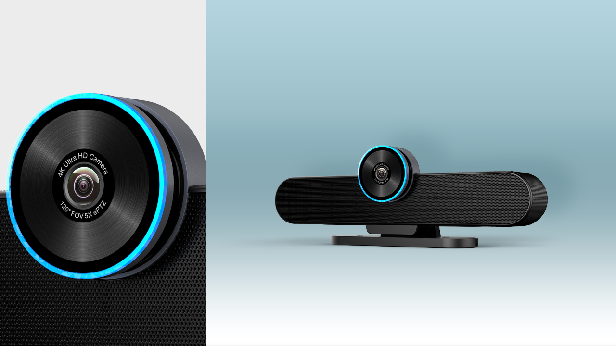


COLLABORATION BAR GAMMA
6-ELEMENT
Mic array and 5m voice pickup range
ALL-IN-ONE
Camera, speaker
and microphone
ADVANCED SOUND
Noise reduction and echo cancelation features
4K
Camera with 5X digital zoom
128⁰
Viewing Angle
AI INTELLIGENT TRACKING
Presenter smooth automatic tracking

Slide 29
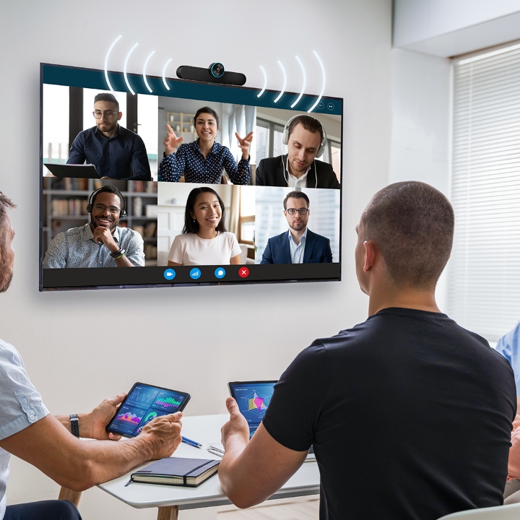
COLLABORATION BAR GAMMA (PVCCU8M601)
All-in-one solution for online collaboration: integrated conference camera, microphone and speaker in one device with plug&play simplified setup.
Compatible with most OS and devices: Multiboards, laptops, PCs, etc.
Handles different lightning environments, reduces image noise under low illumination
Easy & flexible installation: mount on the wall, put it on a desk or fix it on the screen
Smooth and minimal design, balanced pricing
Perfect to use at open office spaces, small and medium meeting rooms, executive office, etc.

Slide 30
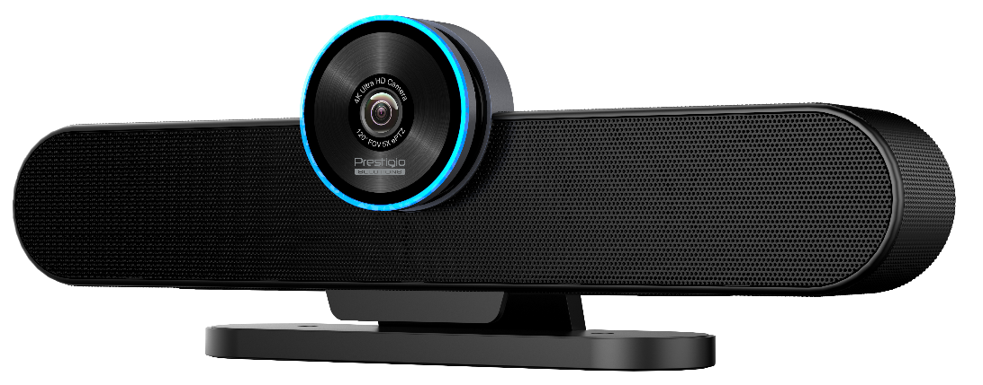
COLLABORATION BAR GAMMA (PVCCU8M601)
RESOLUTION | UHD (3840 x 2160)
PIXEL | 8.5M
IMAGE SENSOR | 1/2.8” SONY Low illumination sensor
RESOLUTION SUPPORT | 4K@30fps (max.)
FIELD OF VIEW | DFOV: 128⁰ / HFOV: 120⁰ / VFOV: 60⁰
FOCUS MODE | Fixed Focus (2.2mm)
DIGITAL ZOOM | 5X
SOUND CHANNEL | 2.0
OUTPUT POWER | 2 x 5W
DIGITAL NOISE REDUCTION | 2D & 3D digital noise reduction
MIC ELEMENTS | 6
VOICE PICUP RANGE | 0~5m
AI INTELLIGENT TRACKING | Supported
INTERFACES | USB Type-B x 1, Headphone jack 3.5 x 1, DC 4.0 x 1
DIMENSIONS (LxHxD), mm | 352 x 118.5 x 75.5
WEIGHT (NET/GROSS), kg | 0,86 / 1,82
IN THE BOX | QSG, Warranty card, USB Cable x 1, Remote Control x 1, Power Adapter x 1
PRICE LCP DCZL, (incl. PC/OS) | $150 w/o VAT
PRICE LCP CN, (incl. PC/OS) | $135 w/o VAT
Authorized Partner Price | $185 w/o VAT
RDP / RRP | $199 / $243 w/o VAT
Production lead time | 2.5 months
Plus delivery | Air – 2 weeks, train – 3 weeks
One model MOQ | 1000 pcs from all subs
Orders based on commitment from all subs
PRICE LCP DCZL, (incl. PC/OS) | $150 w/o VAT
PRICE LCP CN, (incl. PC/OS) | $135 w/o VAT
Authorized Partner Price | $185 w/o VAT
RDP / RRP | $199 / $243 w/o VAT
Production lead time | 2.5 months
Plus delivery | Air – 2 weeks, train – 3 weeks
One model MOQ | 1000 pcs from all subs
Orders based on commitment from all subs
RDP / RRP | $199 / $243 w/o VAT
Production lead time | 2.5 months
Plus delivery | air – 2 weeks, train – 3 weeks
One model MOQ | 500 pcs from all subs
Orders based on commitment from all subs

Slide 31
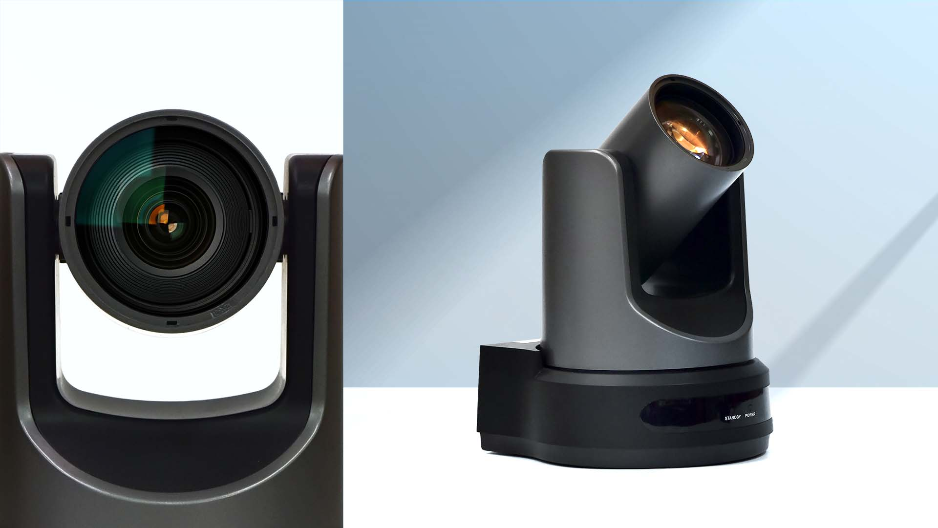
WIRELESS PTZ CAMERA GAMMA
WIRELESS BROADCAST
Distance up to 200 meters
192 TIMES ZOOM RATIO
12x Optical and 16x digital zoom
MULTIPLE INTERFACES
HDMI, 3G-SDI and NETWORK
can output at the same time
FULL HD
Conference camera with
1920 x 1080 resolution
NETWORK REMOTE CONTROL
VISCA over IP, ONVIF, SDK control

Slide 32
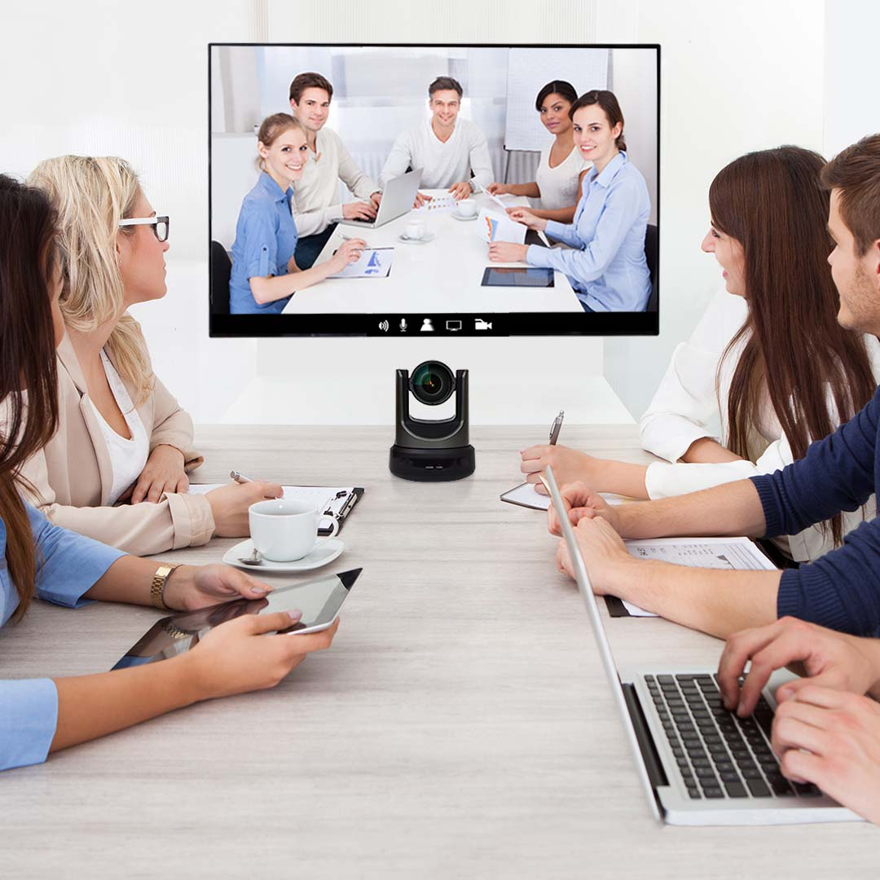
WIRELESS PTZ
CAMERA GAMMA (PSVCCF2N001)
Compact and lightweight FHD camera for professional visual communications anytime and anywhere.
H.265 support to ensure stable and reliable wireless video stream
12x optical and 16x digital zoom to ensure unsurpassed video quality
Smooth pan-tilt-zoom operation for the most comfortable work
Multiple interfaces with output at the same time, PoC technology support
Perfect to use for medium and large meeting rooms and conference halls.

Slide 33
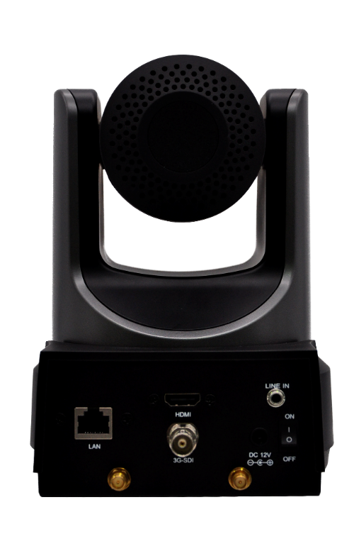
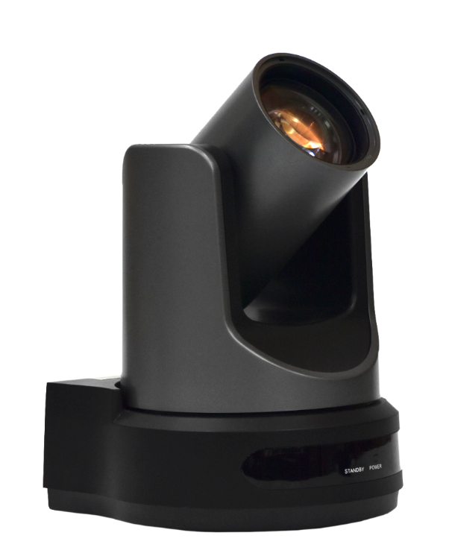
WIRELESS PTZ CAMERA GAMMA
(PSVCCF2N001)
RESOLUTION | FHD (60fps)
PIXEL | 2.07M
SENSOR | 1/2.7” PANASONIC high quality HD CMOS sensor
OUTPUT FORMAT | MJPG / H.264 / H.265
FIELD OF VIEW (HORIZONTAL/VERTICAL) | 72.5° ~ 6.9° / 44.8° ~ 3.9°
ROTATION RANGE (HORIZONTAL/VERTICAL) | ±170⁰ / -30° ~ +90°
LENS | 12x, f = 3.5mm ~ 42.3mm, F 1.8 ~ F 2.8
DIGITAL ZOOM | 16x
DIGITAL NOISE REDUCTION | 2D & 3D digital noise reduction
HORIZONTAL & VERTICAL FLIP | Supported
SUPPORT PROTOCOLS | TCP/IP, HTTP, RTSP, RTMP, ONVIF, DHCP, Multicast
PENETRATION | 1~2 walls
BROADCAST DISTANCE | 200 meters (for longer distances, with higher gain antennas)
INTERFACES | RJ45 (10M/100M) x 1, Wi-Fi (5G) x1, HDMI (v.1.3) x 1, 3G-SDI (PoC support) x 1, LINE IN 3.5mm Audio Interface x 1, JEITA type (DC IN 12V)
IN THE BOX | QSG, Warranty card, Antenna x 4, Camera Power adapter x 1 (incl. cables with EU and UK plugs), Peeping cover x 1, Lens hood x 1, Transmitter/Receiver x 1, T/R Power adapter x 1, UK Plug adapter x 1, Remote control x 1
RDP / RRP | $809 / $995 w/o VAT
Production lead time | 2.5 months
Plus delivery | air – 2 weeks, train – 3 weeks
One model MOQ | 100 pcs from all subs
Orders based on commitment from all subs

Slide 34
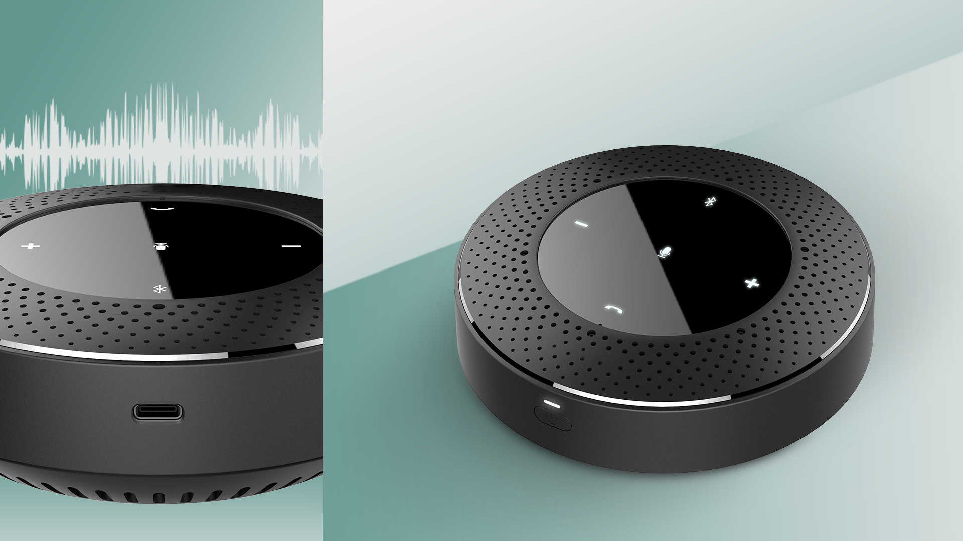
SPEAKERPHONE
GAMMA
CLEAR SOUND
Automatic noise reduction and echo cancelation
UP TO 5 METERS
voice pickup range
UP TO 20 HOURS
of battery life
6-ELEMENT
Mic array, omnidirectional
PLUG&PLAY
Bluetooth/USB/AUX connection

Slide 35

SPEAKERPHONE
GAMMA (PVCSN0M602)
Simple portable solution with extra long battery life.
Compatible with most OS and devices: Multiboards, laptops, PCs, smartphones, etc.
Plug&play function. Can be connected via Bluetooth, USB.
Smooth and minimal design, balanced pricing
Up to 20 hours of battery life, wired charging (Type-C cable)
Perfect to use at open office spaces, meeting rooms of any size, executive office, etc.

Slide 36
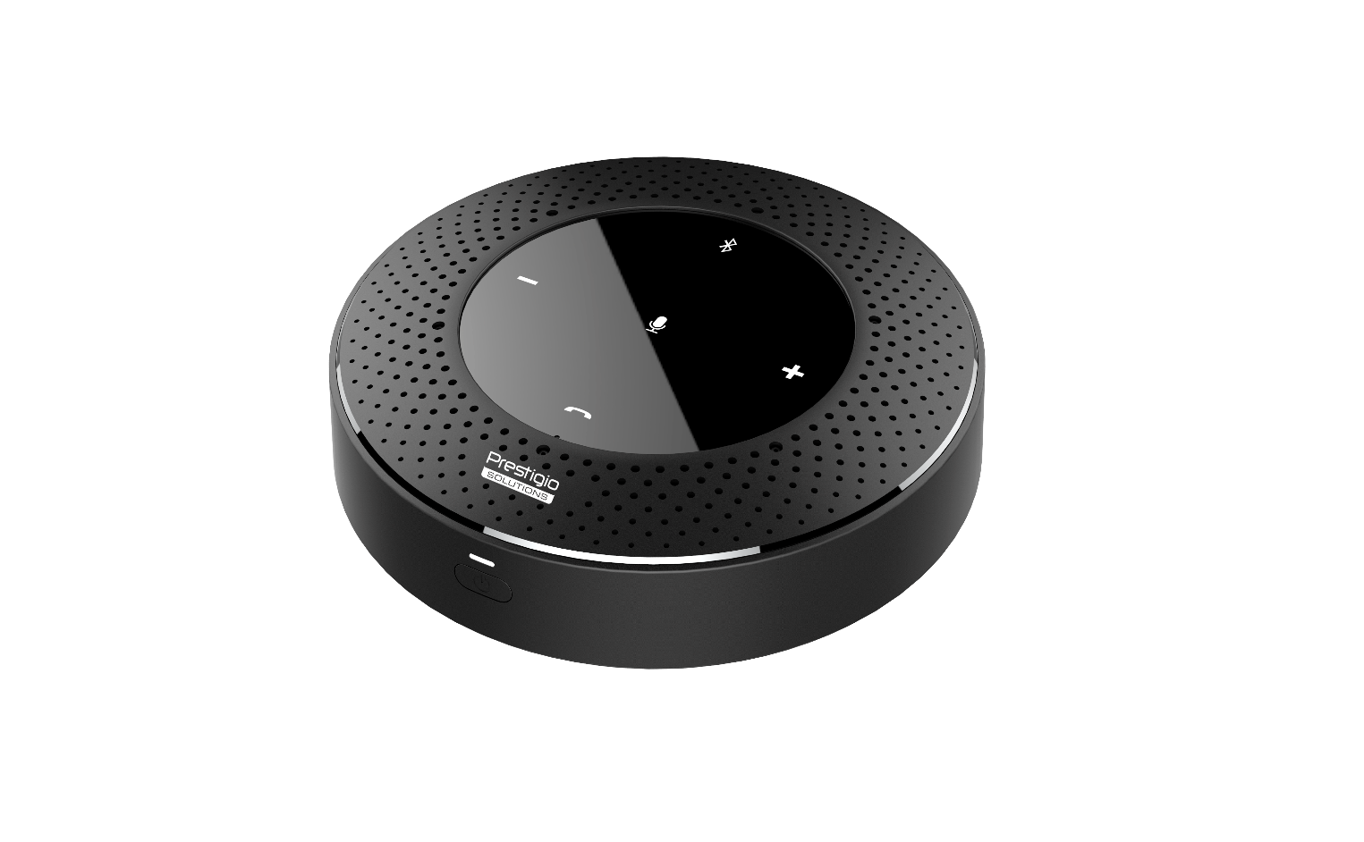
SPEAKERPHONE GAMMA (PVCSN0M602)
MICROPHONE | 6-Element Array, Omnidirectional
VOICE PICKUP RANGE | 4m-5m (Radius)
SPEAKER SOUND CHANNEL | 1.0
INTERFACES | USB Type-C x 1 (Audio IN/OUT + Charge 5V/2A), Bluetooth 5.0 (HSP1.2, HFP1.7, A2DP1.3, AVRCP1.6)
LED INDICATOR LIGHT | Power / Volume - & + / BT / Call / Mic
BATTERY CAPACITY | 7.4V/5200mAh
BATTERY CHARGING | Wired: 5V/2A
CONTINUOUS WORKING TIME | 20h
DIMENSIONS (DIAMETER x HEIGHT), MM | 120 x 41
WEIGHT (NET/GROSS), G | 390 / 692
IN THE BOX | QSG, Warranty card, USB Type-C Cable x 1, Power adapter x 1, USB Dongle(Bluetooth) x 1
RDP / RRP | $76 / $93 w/o VAT
Production lead time | 2.5 months
Plus delivery | air – 2 weeks, train – 3 weeks
One model MOQ | 500 pcs from all subs
Orders based on commitment from all subs

Slide 37
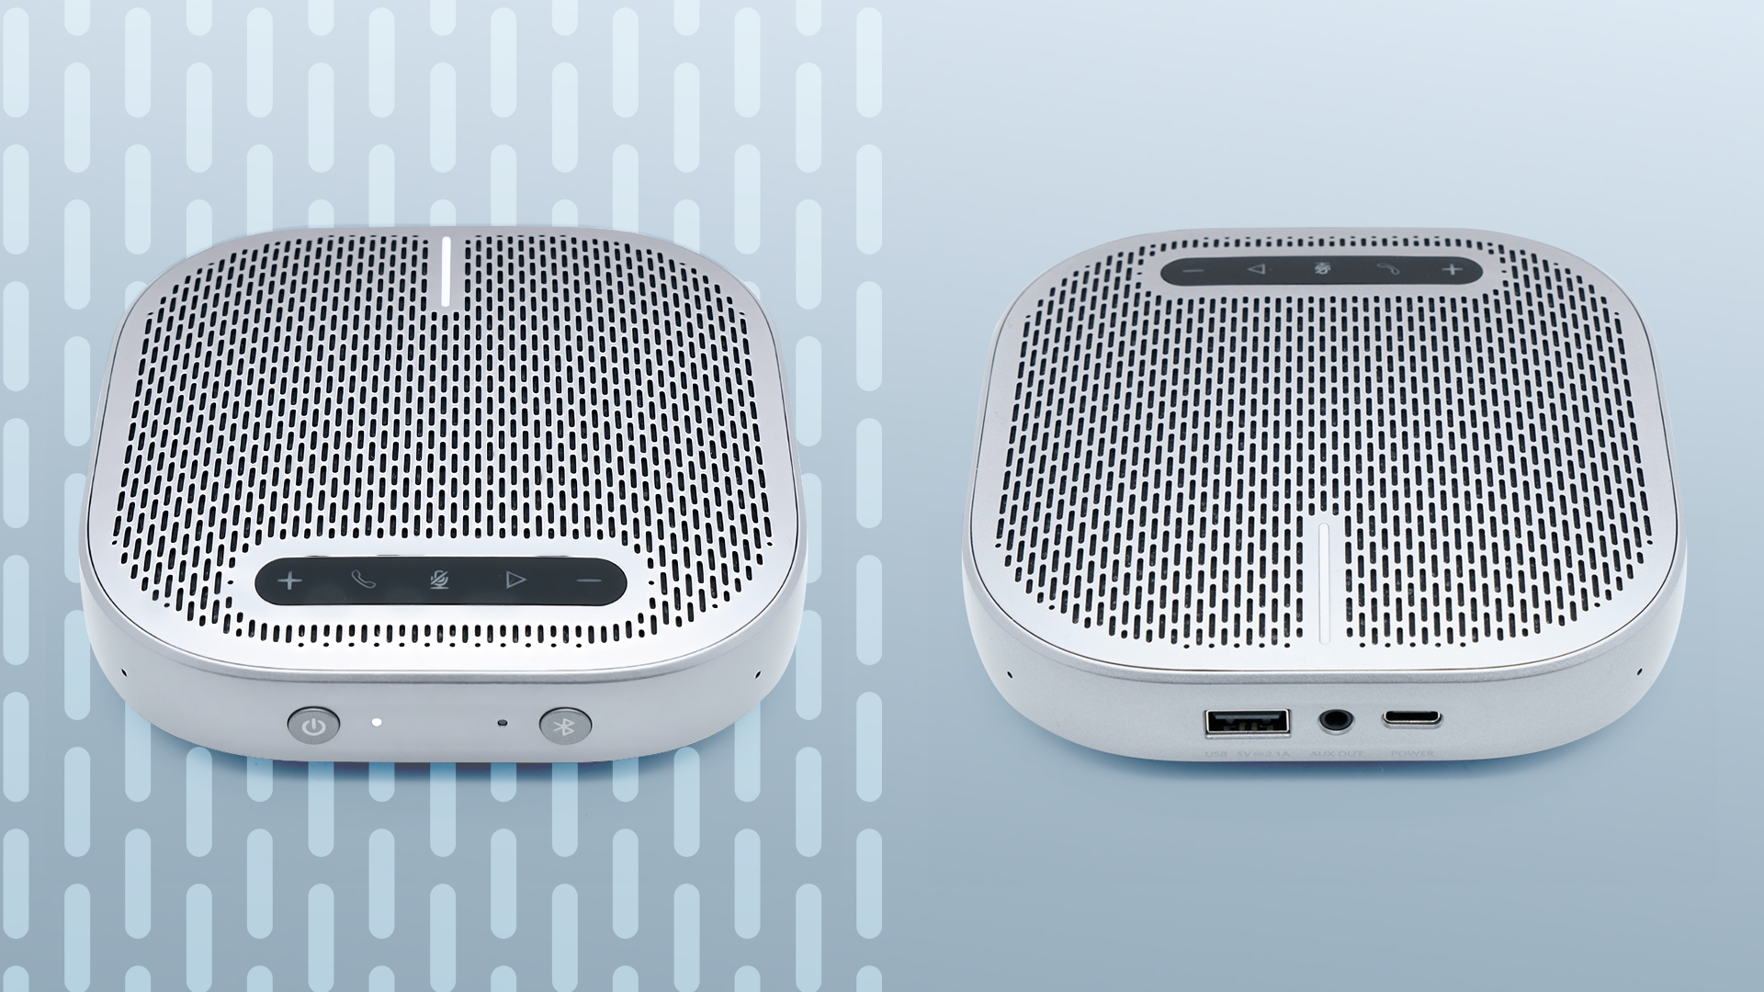
CLEAR SOUND
Automatic noise reduction and echo cancelation
SPEAKERPHONE
DELTA
UP TO 6 METERS
voice pickup range
4-ELEMENT
Mic array, omnidirectional
UP TO 24 HOURS
of battery life
PLUG&PLAY
Bluetooth/USB/AUX connection

Slide 38
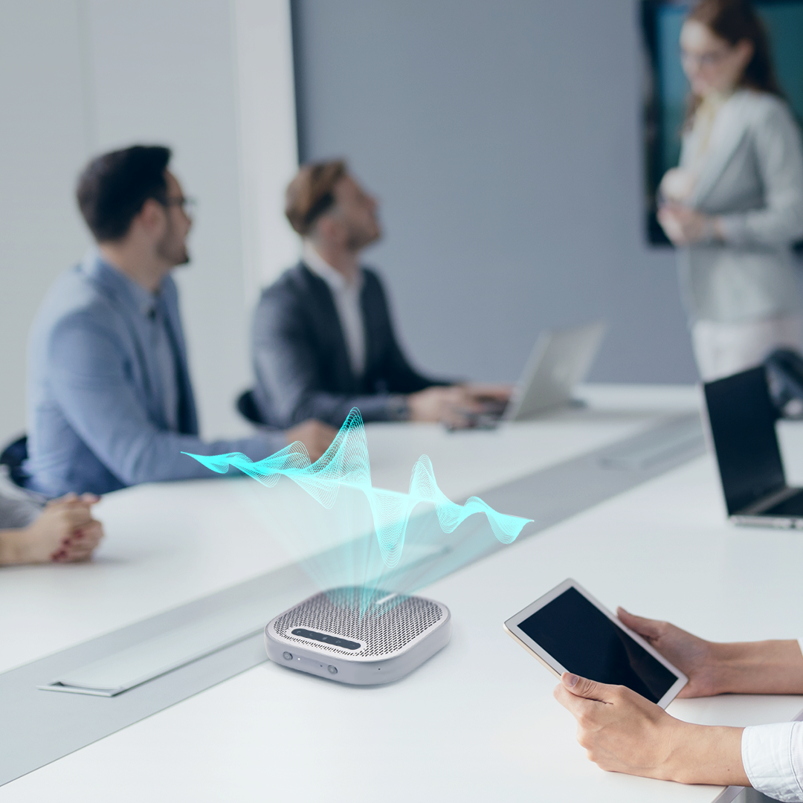
SPEAKERPHONE
DELTA (PVCSN0M401)
Simple portable solution with extra long battery life.
Compatible with most OS and devices: Multiboards, laptops, PCs, smartphones, etc.
Plug&play function. Can be connected via Bluetooth, USB.
Smooth and minimal design, balanced pricing
Up to 24 hours of battery life, wired charging (Type-C cable)
Perfect to use at open office spaces, meeting rooms of any size, executive office, etc.

Slide 39
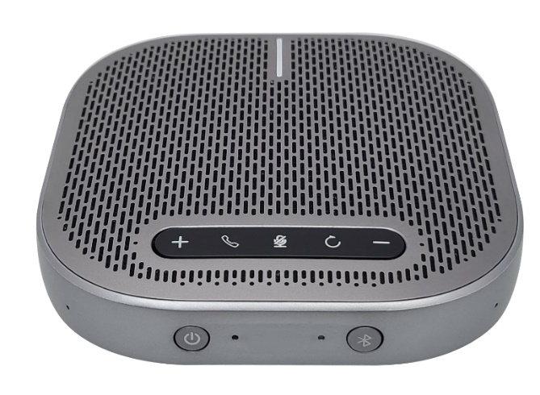
SPEAKERPHONE DELTA (PVCSN0M401)
MICROPHONE | 4-Element Array, Omnidirectional
VOICE PICKUP RANGE | 6m (Radius)
SPEAKER SOUND CHANNEL | 1.0
OUTPUT POWER | 5W
INTERFACES | USB Type-C x 1 (Audio Input/Call + Charge 5V/2A), USB Type-A x 1 (Charge peripherals), Bluetooth 5.0 (AVRCP, A2DP, HFP and SBC CODEC ), AUX Output 3.5mm
LED INDICATOR LIGHT | Power / Bluetooth
BATTERY CAPACITY | 6500mAh
BATTERY CHARGING | Wired: 5V/2A
CONTINUOUS WORKING TIME | 24h
DIMENSIONS | 124m x 124mm x 32mm
WEIGHT (NET), G | 320
IN THE BOX | QSG, Warranty card, USB Type-C Cable x 1, Power adapter x 1
RDP / RRP | $124 / $152 w/o VAT
Production lead time | 2.5 months
Plus delivery | air – 2 weeks, train – 3 weeks
One model MOQ | 100 pcs from all subs
Orders based on commitment from all subs

Slide 40
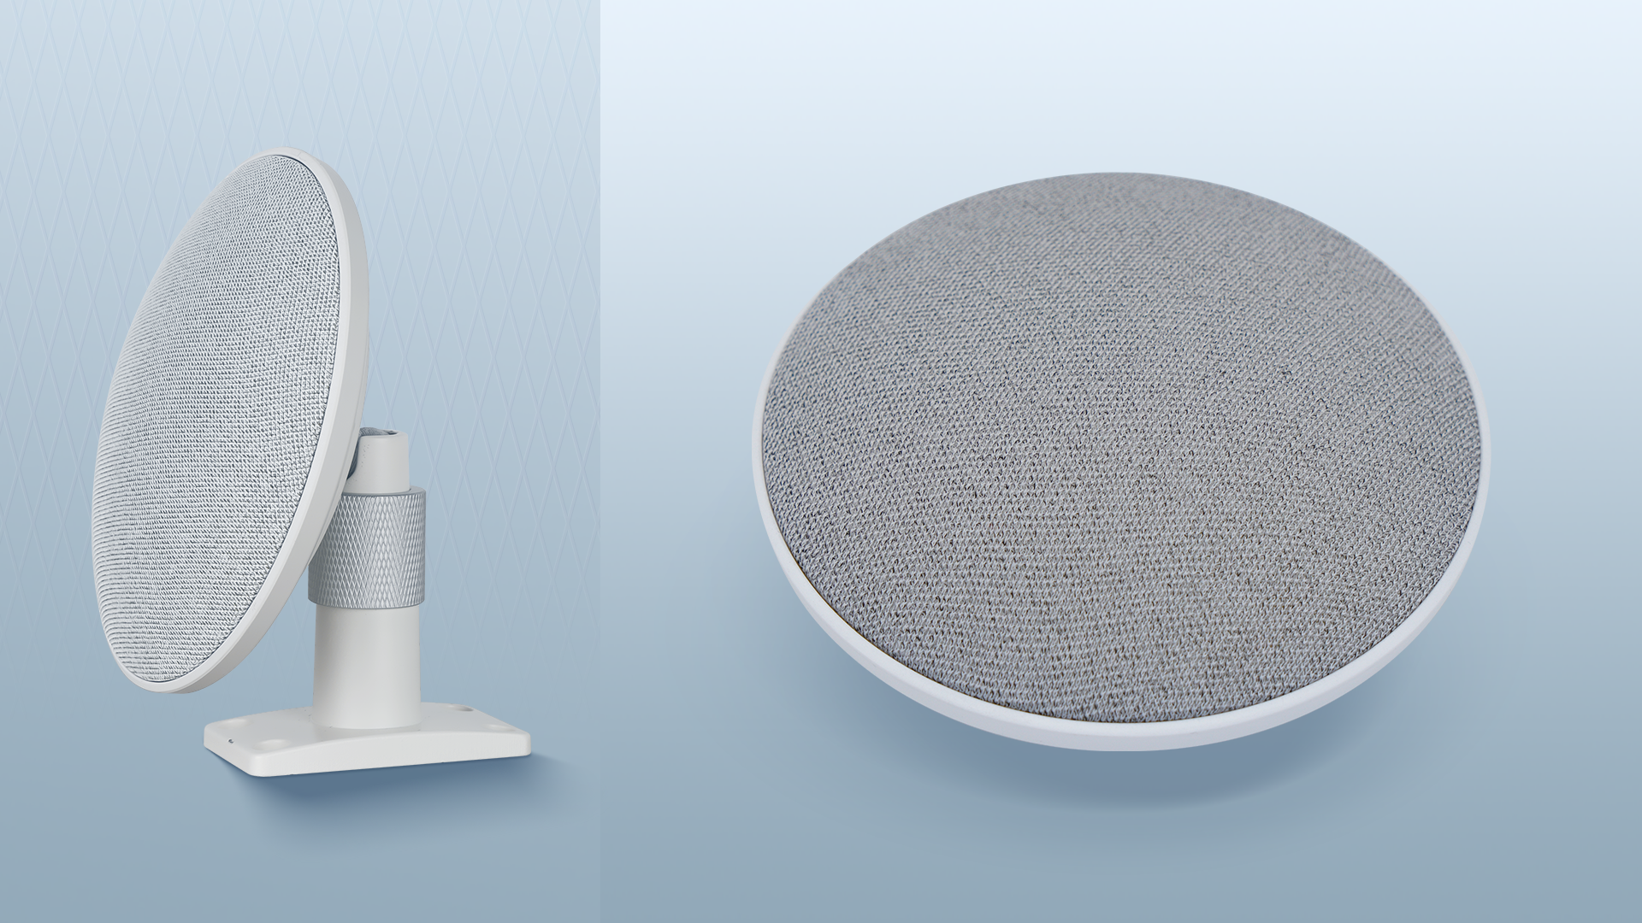
DIGITAL ARRAY
MICROPHONE ALPHA
7-ELEMENT
Mic array, omnidirectional
UP TO 8 METERS
voice pickup range
PLUG&PLAY
Easy to install and maintain
HIGH QUALITY OF SOUND
Noise reduction, echo cancellation and reverberation suppression
INTELLIGENT VOICE TRACKING
Adaptive blind beamforming technology

Slide 41
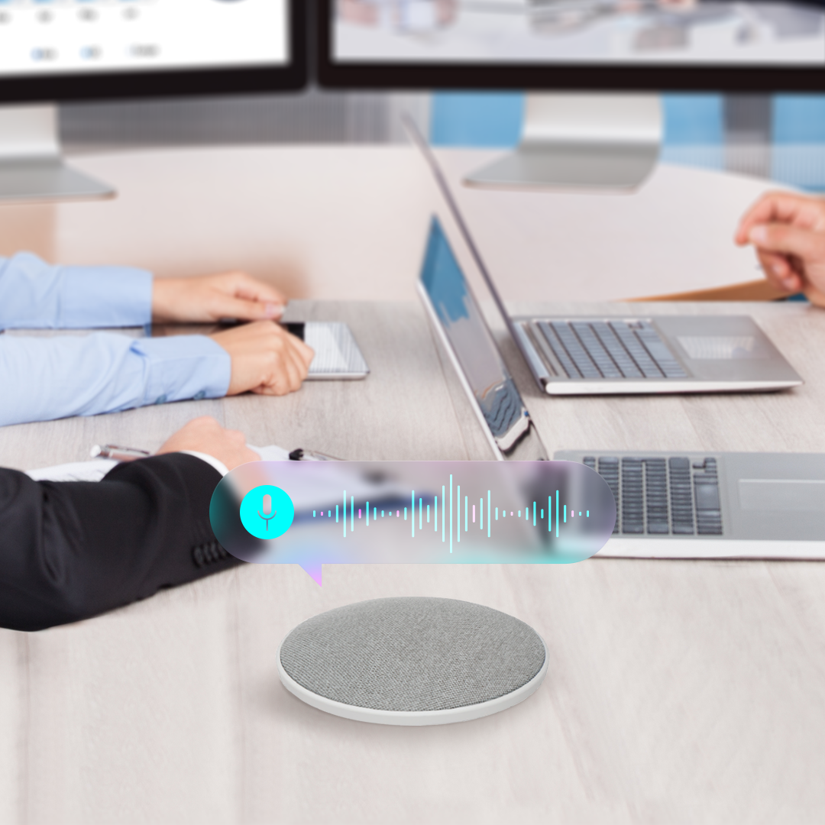
DIGITAL ARRAY MICROPHONE ALPHA
(PSVCMN0M701)
Digital array microphone with superior audio pickup which can be adapted to any room interior.
A hands-free lecture or presentation solution with long distance voice pickup (up to 8 m).
Automatic speaker alignment and speech reinforcement to keep it clear.
Intelligent noise reduction, echo cancellation and reverberation suppression to ensure clear sound.
Easy to install and maintain. Plug&play.
Smooth and minimal design. Can be adapted to any interior.

Slide 42
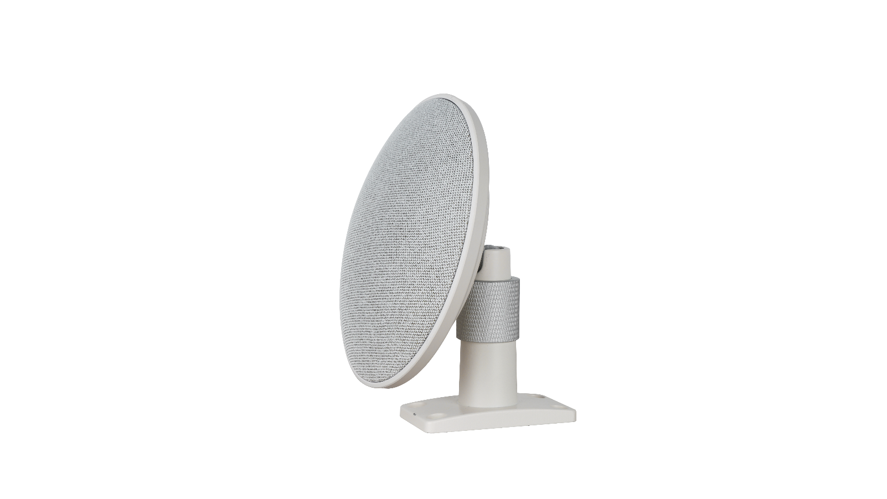
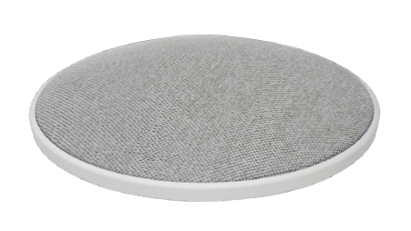
DIGITAL ARRAY MICROPHONE ALPHA (PSVCMN0M701)
DIRECTIVITY CHARACTERISTIC | 360°
MICROPHONE ARRAY | Built-in 7 microphone arrays
PICKUP RADIUS | 8m
SENSITIVITY | -26 dBFS
FREQUENCY RESPONSE | 20Hz - 16kHz
SAMPLING RATE | 32K sampling, High Definition Broadband Audio
USB PROTOCOL | Support UAC
AUDIO ALGORITHMS | AEC, ANS, AGC, Reverberation Suppression
INTERFACES | Audio Line In (3.5mm) x 1, Audio Line Out (3.5mm) x 2, USB 2.0 x 1
POWER | USB DC5V
DIMENSIONS (DIAMETER x HEIGHT), MM | 130 x 33
IN THE BOX | QSG, Warranty card, USB Cable x 1, Power adapter x 1
RDP / RRP | $251 / $309 w/o VAT
Production lead time | 2.5 months
Plus delivery | air – 2 weeks, train – 3 weeks
One model MOQ | 100 pcs from all subs
Orders based on commitment from all subs

Slide 43
SPECIAL OFFER

Slide 44

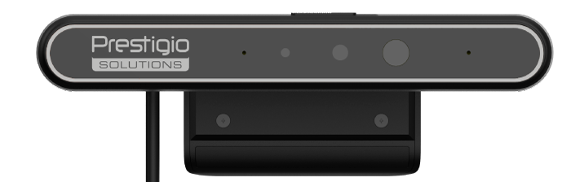

Q1’ 2023
SPECIAL OFFER
FOR PARTNERS
Windows Hello Camera
24% OFF
RDP = 51 67 USD
RRP = 63 80 USD

Slide 45

Your reliable partner
in solutions for business

